Slide 1


5 Year Survival
of
NBA Rookies
Muthukumar Kadhirvel​​

Slide 2
BUSINESS Problem
Rookies - professional athletes in their first year
NBA draft - Add rookies to their teams
First round of the NBA draft - Contract is of 2 years with full guarantee and the 3rd and 4th years being options.
Rest - Contract from 1 to 4 years with no guarantees.
Average career length of an NBA player is 4.5 years.
Identify rookie players who will benefit them in the long term.
Build predictive model using rookie year statistics that predicts whether a rookie NBA player will last 5 or more years in the league

Slide 3
Data Processing - EDA
Rookie year statistics dataset from Kaggle ​
Contains the rookie year statistics of players from 1980 to 2015
Has 1424 rows and 22 columns
Feature variables – All variables except target are numeric and continuous variables
Target variable – Whether rookie player will last 5 years in the league ( 0 – No / 1 – Yes)
No missing or NULL values
Since all variables are numeric and continuous there is no need to create dummy variables

Slide 4
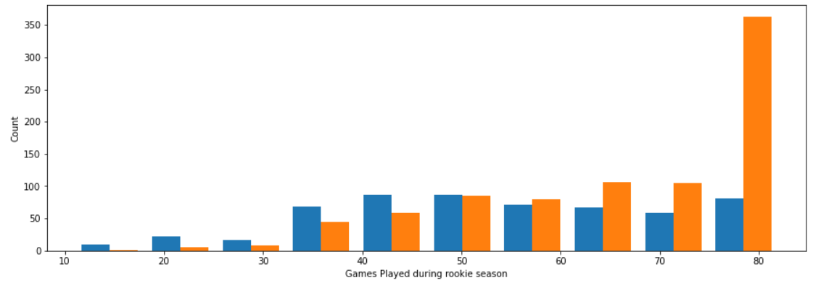
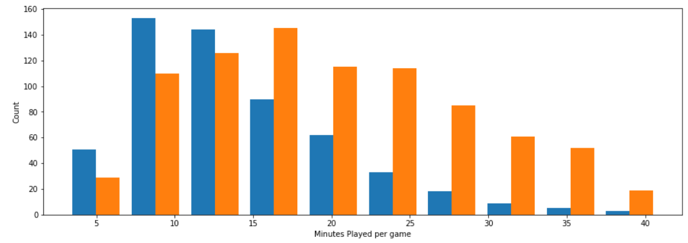
Visualization
Games Played - Rookies that play less than 60 games do not last 5 years in the league.
Minutes Played - Rookies that play less than 15 minutes per game do not last 5 years in the league.
4

Slide 5
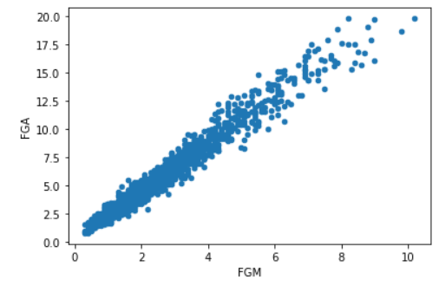
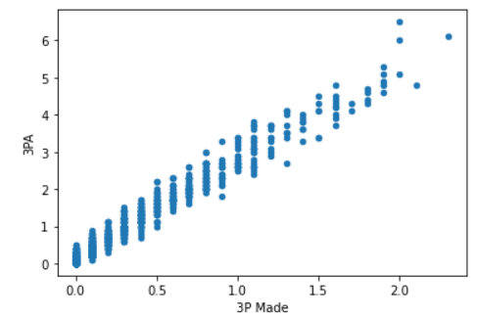
Visualization (Cont.)
Scatter plots of FGM/FGA and 3P Made/3PA
High positive correlation between field goals made per game and field goals attempted per game
High positive correlation between 3-point field goals made per game and 3-point field goals attempted per game
5

Slide 6
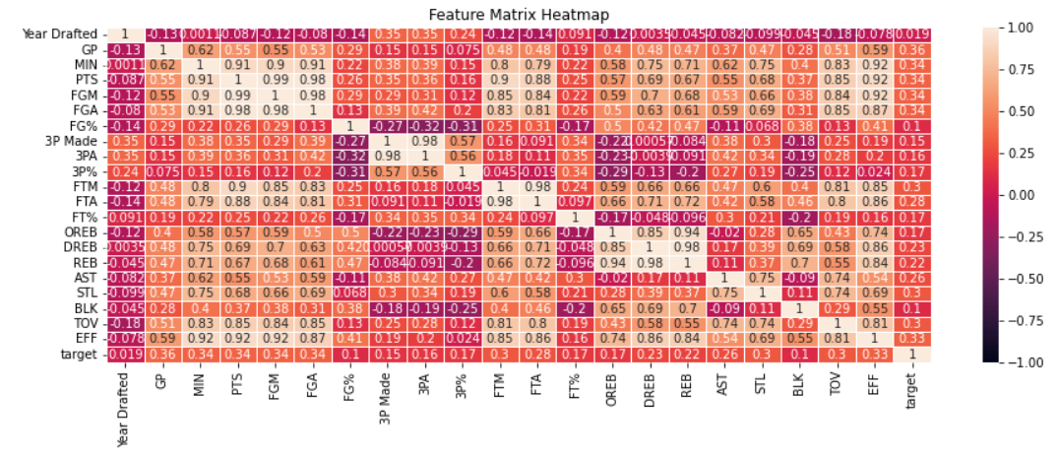
Visualization (Cont.)
Pearson Correlation – Continuous Variables against Target
No variables have good correlation with target variable
Games Played has the most correlation followed by Minutes Played
6

Slide 7
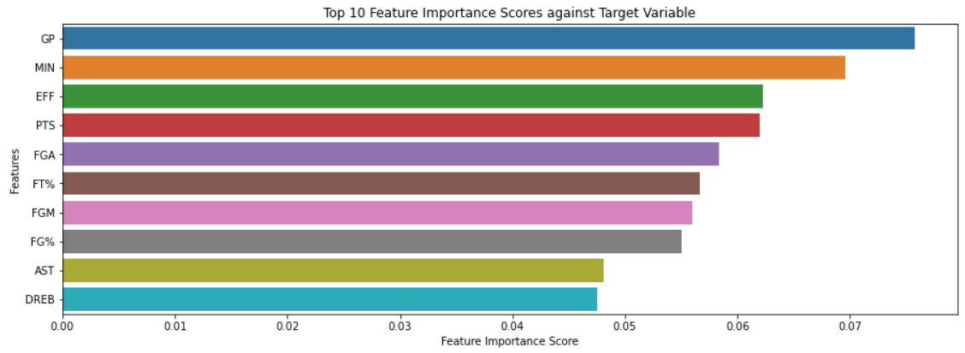
Visualization (Cont.)
Top 10 Feature Importance Scores against Target Variable
Games Played has the most importance followed by Minutes Played
7

Slide 8
Models and Metrics
Binary classification problem
Models Used - ​Logistic Regression / KNN / Support Vector Machine / Random Forest Classifier
Split into training dataset and test dataset in the ratio of 80% to 20%
Target is whether rookie player last 5 years in the league
Features series has the rest of the columns.
Accuracy is used as the evaluation metric
Confusion matrix ensures the number of false positive and false negatives are less

Slide 9
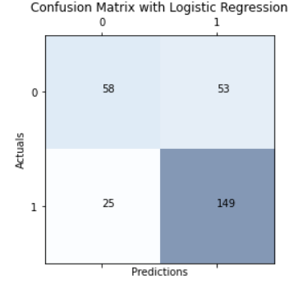
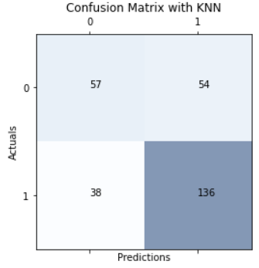
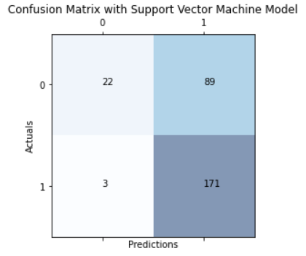
Model Evaluation
Logistic Regression/KNN/Support Vector Machine - Good accuracy but bad at predicting Target variable
Support Vector Machine – Has more False Positives than other models

Slide 10
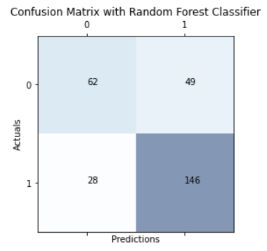
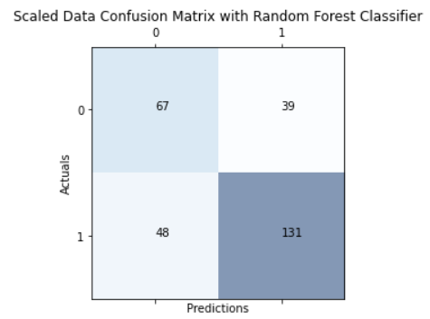
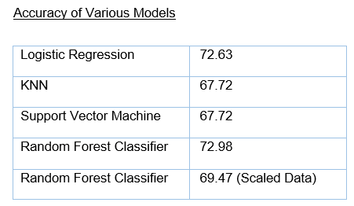
Model Evaluation (Cont.)
Random Forest Classifier – Better Accuracy and Confusion Matrix
MinMaxScaler was performed on the dataset and accuracy and Confusion Matrix yielded lower results

Slide 11
CONCLUSION
Random Forest Classifier model yielded the best results and will be used to go ahead with implementation
Continue to input more sample data that becomes available to retrain our model
Recurring mechanism to keep the model in line with the current data
Can use this model to predict binary classification problems in other sports
Factors like Race/ Injuries etc. could also be crucial factors

Slide 12
References
Wright, S. et al. (2022) NBA rookie contracts explained, Franchise Sports. Available at: https://franchisesports.co.uk/nba-rookie-contracts-explained (Accessed: March 19, 2023).
Luke (2021) What is the average career length of an NBA player?, Dunk or Three. Available at: https://dunkorthree.com/nba-player-career-length/ (Accessed: March 19, 2023).
Daubs, K. (2021, November 25). Top 10 NBA players with the most PPG during a rookie season. Retrieved April 2, 2023, from https://fadeawayworld.net/nba/top-10-nba-players-with-the-most-ppg-during-a-rookie-season-wilt-chamberlain-was-a-scoring-god-since-his-first-season

Slide 13

THANK YOU
Muthukumar Kadhirvel​​
402-301-2069
mkadhirvel@my365.bellevue.edu

